Slide 1



Medical Nutrition Therapy for CVD Patients
Jessy El Hayek
July 8th, 2024

Slide 2

Outline
Case Study 1: Meet Sara
Components of the Medical Nutrition Therapy
Cardiovascular Disease
Cardiovascular Health and the Nutrition Care Process
A. CVD & Nutrition Assessment
B. CVD & Nutrition Diagnosis & Intervention
C. CVD & Nutrition Monitoring & Evaluation
V. Life Course of Cardiovascular Health
VI. Conclusion
VII. Case Study 2: Meet Chadi

Slide 3
Make Yourself Heart Attack Proof: Video
Bill Clinton on CNN - "Make Yourself Heart Attack Proof"
https://www.facebook.com/watch?v=598927010455877

Slide 4

Case study: Meet Sara
Patient Profile:
Age: 55 years Gender: Female Occupation: Retired teacher
Presenting Complaint: Sarah reports occasional shortness of breath and fatigue during daily activities.

Slide 5
Case study: Meet Sara
Assessment:
Laboratory Findings: LDL:160 mg/dL, HDL: 40 mg/dL, fasting blood glucose: 90 mg/dL, triglycerides:120 mg/dL.
Physical Examination: Blood pressure: 140/90 mmHg, BMI: 29 kg/m²
Medical History: family history of cardiovascular disease (father had a heart attack at age 62 y).
Lifestyle: Sedentary lifestyle, consumes a typical Western diet high in processed foods, minimal vegetable and fruit intake, occasional smoking (5 cigarettes per day), moderate alcohol intake (1-2 glasses of wine per day).

Slide 6
Case study: Meet Sara
Diagnosis
ECG shows signs of left ventricular hypertrophy
Overweight (BMI 29 kg/m²)
Hypertension
Elevated LDL cholesterol
low HDL
Unhealthy diet
Sedentary lifestyle
Intervention:
Lifestyle: Heart healthy diet- smoking cessation-physical activity-
Lipid lowering medications
Antihypertensive medications

Slide 7
Case study: Meet Sara
Monitoring & Evaluation
Schedule regular follow-up visits to monitor Sarah's progress, adjust treatment plans as needed, and reinforce lifestyle modifications.
Engage Sarah in shared decision-making regarding her health goals and treatment options, fostering empowerment and motivation.
Collaborate with other healthcare providers (e.g., physicians, nurses, dietitians, psychologists, etc.) to ensure comprehensive care and support for Sarah's cardiovascular health.

Slide 8
II. Components of the Medical Nutrition Therapy

Slide 9
Components of the Medical Nutrition Therapy
Nutrition Care Process is a systematic method that dietitians use to provide nutrition care. It is comprised of four steps:
nutrition assessment and reassessment,
nutrition diagnosis,
nutrition intervention and
nutrition monitoring and evaluation.
The Nutrition Care Process provides a framework for practitioners to customize care — taking into account the client's needs and values and using the best evidence available to make decisions.
AND, 2008
Notes:
Use of the Nutrition Care Process does not mean that all patients get the same care.
Use of the Nutrition Care Process can lead to more efficient and effective care, nutrition research and greater recognition of the role of credentialed nutrition and dietetics practitioners.

Slide 10

Nutrition Care Process
Nutrition Assessment: Collection of information such as food or nutrition-related history; biochemical data, medical tests and procedures; anthropometric measurements, nutrition-focused physical findings and client history.
AND, 2008

Slide 11
Nutrition Care Process
Nutrition Assessment: Collection of information such as food or nutrition-related history; biochemical data, medical tests and procedures; anthropometric measurements, nutrition-focused physical findings and client history.
Nutrition Diagnosis: Identification of the appropriate nutrition diagnosis (i.e., naming the specific problem).
AND, 2008

Slide 12

Nutrition Diagnosis
Intake nutrition diagnosis
  High intake of calories
  High intake of fats
  Low intakes of fibers
Clinical nutrition diagnosis
  Obesity
  Hyperlipidemia
  Hypertension
  Diabetes
Behavioral-environmental nutrition diagnosis
  Food insecurity
  Intake of unsafe food
AND, 2008
Notes:
Based on assessment findings, establish nutrition-related diagnoses related to cardiovascular disease risk factors. Examples include:Excessive intake of saturated fats contributing to elevated LDL cholesterol levels.
Inadequate intake of fruits and vegetables impacting blood pressure control.
Overweight status exacerbating cardiovascular risk.

Slide 13
Nutrition Care Process
Nutrition Assessment: Collection of information such as food or nutrition-related history; biochemical data, medical tests and procedures; anthropometric measurements, nutrition-focused physical findings and client history.
Nutrition Diagnosis: Identification of the appropriate nutrition diagnosis (i.e., naming the specific problem).
Nutrition Intervention: Selection of the nutrition intervention that will be directed to the root cause (or etiology) of the nutrition problem and aimed at alleviating the signs and symptoms of the diagnosis.
AND, 2008

Slide 14

Nutrition Intervention
Goal planning
Prescription planning
Food or nutrient delivery
Nutrition education & counseling
Coordination of the nutrition care process
AND, 2008
Notes:
Setting Goals: Collaborate with the patient to set realistic and specific nutrition goals based on identified diagnoses.
Dietary Recommendations: Recommend a heart-healthy diet, such as the Mediterranean or DASH diet, tailored to the patient's preferences and cultural considerations.
Emphasize increased intake of fruits, vegetables, whole grains, and lean proteins.
Advise on reducing saturated fats, trans fats, and sodium intake.
Provide guidance on portion control and meal planning to achieve calorie balance and weight management.
Nutrition Education: Provide patient-centered education on the relationship between diet and cardiovascular health, including label reading, meal preparation techniques, and dining out strategies.
2.2 Counseling and Behavioral Therapy:
Utilize motivational interviewing techniques to facilitate behavior change and improve adherence to dietary recommendations.
Address barriers to dietary adherence, such as cultural preferences, budget constraints, and lifestyle factors.
Support the patient in making sustainable lifestyle modifications, including physical activity recommendations and smoking cessation strategies if applicable.

Slide 15
Nutrition Care Process
Nutrition Assessment: Collection of information such as food or nutrition-related history; biochemical data, medical tests and procedures; anthropometric measurements, nutrition-focused physical findings and client history.
Nutrition Diagnosis: Identification of the appropriate nutrition diagnosis (i.e., naming the specific problem).
Nutrition Intervention: Selection of the nutrition intervention that will be directed to the root cause (or etiology) of the nutrition problem and aimed at alleviating the signs and symptoms of the diagnosis.
Nutrition Monitoring/Evaluation: Determination if the client has achieved, or is making progress toward, the planned goals.
AND, 2008

Slide 16

Nutrition Monitoring & Evaluation
Food & nutrition outcomes
Anthropometric measures outcomes
Biochemical data and medical tests outcomes
Physical exam findings outcomes
AND, 2008
Notes:
3.1 Monitoring:
Establish a schedule for follow-up visits to monitor the patient's progress towards nutrition goals.
Monitor changes in anthropometric measurements (e.g., weight, BMI), lipid profiles, blood pressure, and other relevant biomarkers.
Assess dietary adherence and adjustments needed to optimize nutrition therapy.
3.2 Evaluation:
Evaluate the effectiveness of nutrition interventions based on improvements in cardiovascular risk factors and patient outcomes.
Modify the nutrition care plan as necessary to address evolving patient needs and goals.
Document outcomes and communicate findings with other healthcare team members to ensure coordinated care.
4. Outcomes
4.1 Patient Outcomes:
Measure improvements in lipid profiles, blood pressure control, weight management, and overall cardiovascular health.
Evaluate patient satisfaction and quality of life related to dietary changes and lifestyle modifications.
Assess the impact of nutrition interventions on reducing cardiovascular disease risk and preventing complications.
4.2 Quality Improvement:
Use outcomes data to continuously improve nutrition care processes and protocols.
Implement evidence-based practices and guidelines to enhance patient outcomes and promote long-term health.

Slide 17
III. Cardiovascular Disease

Slide 18
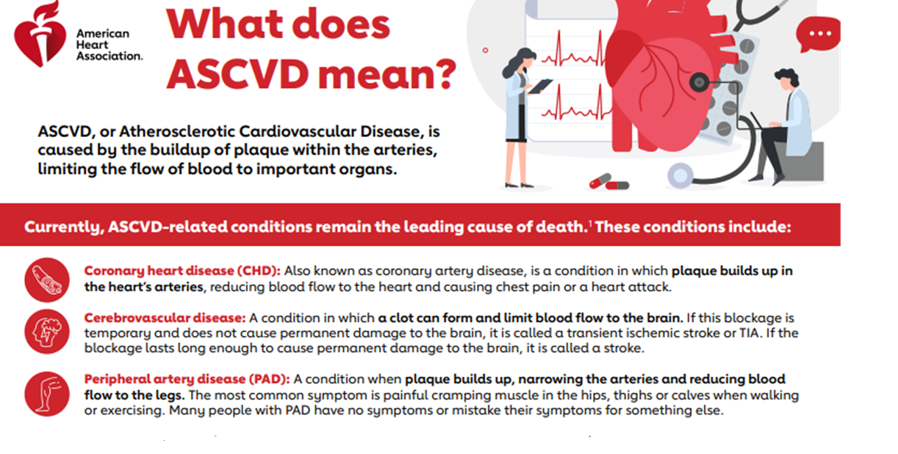

Slide 19
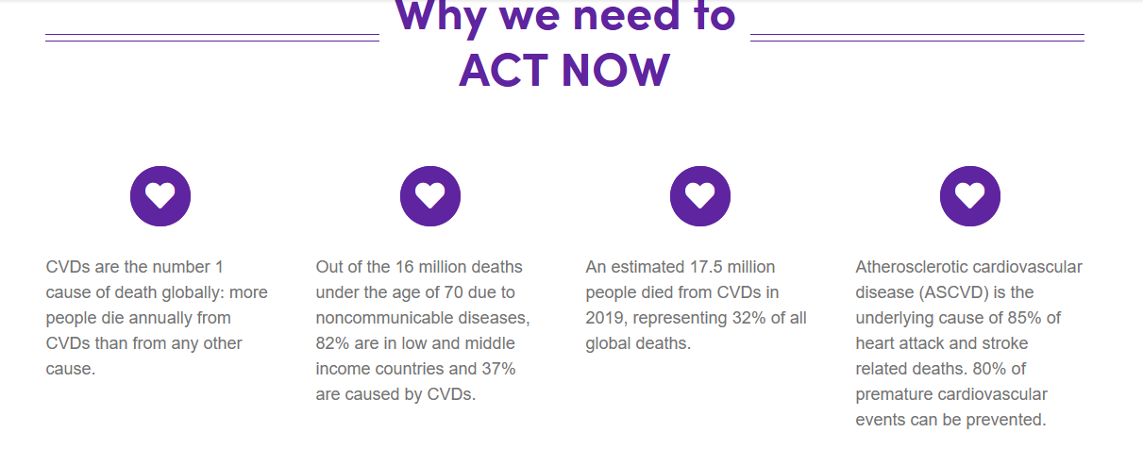
CVD Statistics
WHO, 2021

Slide 20
CVD Statistics
Even though CVD remains the leading cause of worldwide mortality.
Between 1980 and 2000 the mortality rates from coronary heart disease (CHD) in the United States fell by more than 40%.
  Almost 50% of the reduction has been attributed to improvement in lifestyle-related risk factors such as: smoking cessation, increased physical activity, and better control of cholesterol and blood pressure,
  However, increases in obesity and diabetes moved in the opposite direction and could potentially wipeout the gains
Rippe, 2019

Slide 21
CVD Risk Factors: Modifiable & none modifiable
None modifiable
Age
Gender
Genetics
Modifiable
Unhealthy diets
Tobacco use
Alcohol use
Metabolic syndrome (abdominal obesity, impaired fasting glucose, high blood pressure, high triglyceride levels, and low HDL cholesterol levels)
Rippe, 2019

Slide 22
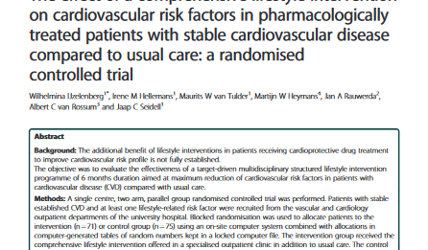
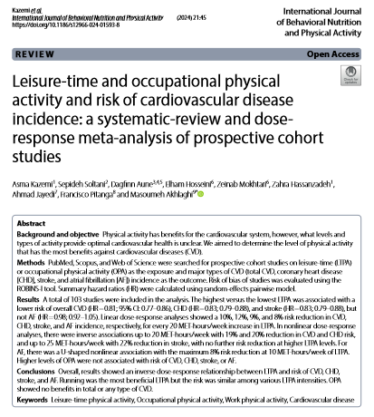
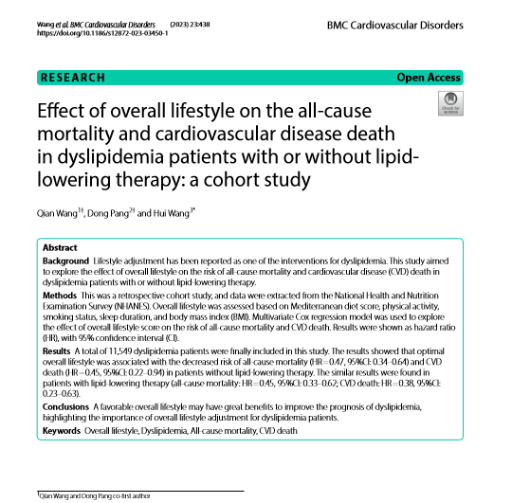
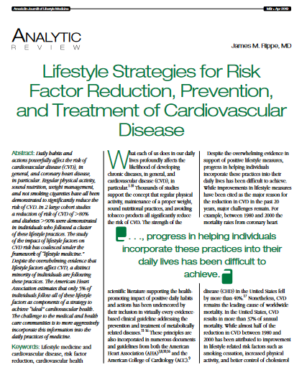
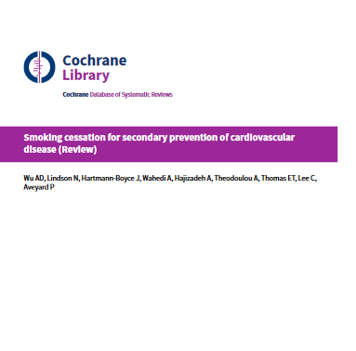
Lifestyle therapy for CVD

Slide 23
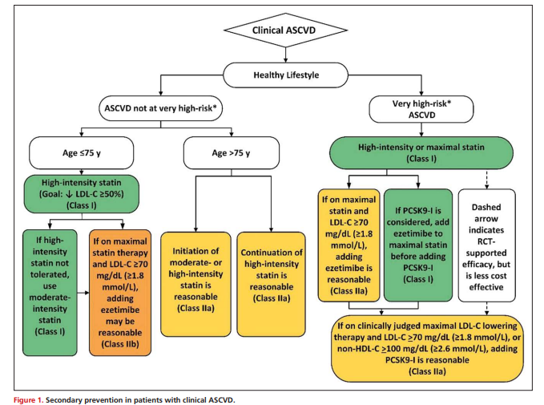
ASCVD Prevention
American College of Cardiology & American Heart Association, 2019
Abbreviations: apoB, apolipoprotein B; ASCVD, atherosclerotic cardiovascular disease; CAC, coronary artery calcium; hsCRP, high-sensitivity C-reactive protein; LDL-C, low-density lipoprotein cholesterol; Lp(a), lipoprotein (a)

Slide 24

American Heart Association’s Construct of Cardiovascular Health
AHA, 2022
Notes:
In 2010, after decades of declines in cardiovascular disease (CVD) death rates, the American Heart Association (AHA) expanded its focus from addressing existing CVD and risk factors to adding strategies that would also directly promote the health of the population and individuals. Central to this new approach was the creation of a novel and operational definition for the construct of cardiovascular health (CVH)
In defininig CVH, the AHA’s 2010 writing group acknowledged that health is a broader, more positive construct than merely the absence of disease. It leveraged relevant existing data and emerging prevention concepts to formulate a definition that was intended to be accessible for all, with ac
Life’s Essential 8 includes the 8 components of cardiovascular health: healthy diet, participation in physical activity, avoidance of nicotine, healthy sleep, healthy weight, and healthy levels of blood lipids, blood glucose, and blood pressure

Slide 25
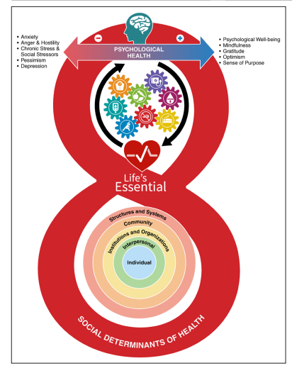
The foundational context of Cardiovascular Health
AHA, 2022
Notes:
In 2010, after decades of declines in cardiovascular disease (CVD) death rates, the American Heart Association (AHA) expanded its focus from addressing existing CVD and risk factors to adding strategies that would also directly promote the health of the population and individuals. Central to this new approach was the creation of a novel and operational definition for the construct of cardiovascular health (CVH).1
As depicted in the social-ecological model in the base of the figure 8, a variety of socioeconomic and structural determinants of health provide the foundational framework that affects an individual’s or a community’s ability to optimize cardiovascular health (CVH). Several interacting factors provide critical context for CVH, including structures and systems (general socioeconomic, cultural, and environmental conditions), community resources (ie, education, agriculture, food production, employment, water and sanitation, health care, and housing), institutions and organizations (in which people learn, grow, eat, sleep, play, and pray), interpersonal social and community networks, and individual genetic and behavioral factors. These foundational social-ecological factors work through and alongside an individual’s psychological health (represented at the top of the 8 in the figure) to provide the context for what is possible in improving or maintaining CVH. There is a continuous interplay of brain-mind-heartbody connections that can positively and negatively affect CVH, which is represented by the 8 component metrics (diet, physical activity, nicotine exposure, sleep, body mass index, blood lipids, blood glucose, and blood pressure) as interacting gears

Slide 26
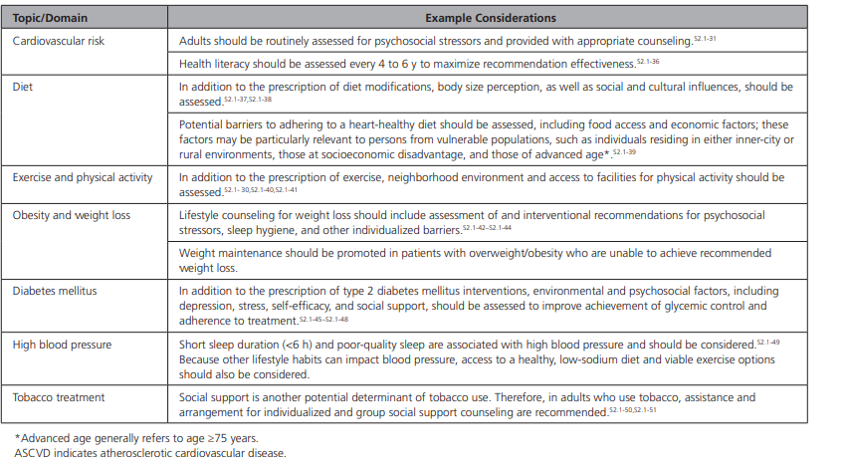
Example Considerations for Addressing Social Determinants of Health
AHA, 2022

Slide 27
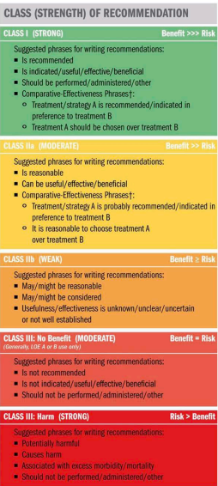
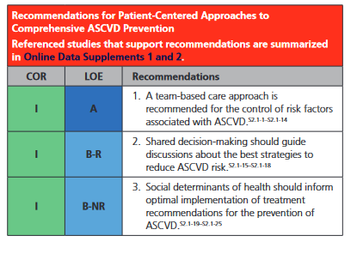
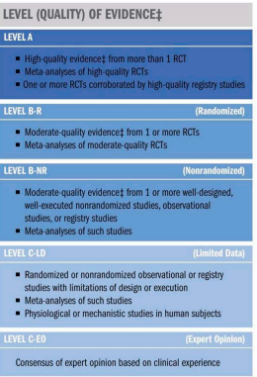
Patient-Centered Approaches to Comprehensive ASCVD Prevention
AHA, 2019
Notes:
AHA Guideline on the Primary Prevention of Cardiovascular Diseas
Recommendations are designated with both a Class of Recommendation (COR) and a Level of Evidence (LOE). The COR indicates the strength of recommendation, encompassing the estimated magnitude and certainty of benefit in proportion to risk. The LOE rates the quality of scientific evidence supporting the intervention on the basis of the type, quantity, and consistency of data from clinical trials and other source.
Team-based care makes use of multidisciplinary
health professionals to improve the quality and
maintenance of ASCVD prevention. It is a multi-
faceted approach that supports clinical decision-
making (ie, treatment algorithms), collaboration
among different clinicians, and patient and fam-
ily member participation to facilitate the treat-
ment goals of patients. S2.1-26 RCTs and systematic
reviews with meta-analyses demonstrated greater
reduction of ASCVD risk with team-based care
than with usual care in patients with hyperten-
sion, diabetes, and hyperlipidemia. S2.1-1–S2.1-14 A
team-based approach to ASCVD prevention may
result in significant improvements in patient out-
comes S2.1-27 and often meets patient needs bet-
ter than standard care, especially in low-resource
settings and among vulnerable populations. In a
team-based care model that compared patients
enrolled in a preventive cardiology clinic staffed
by advanced practice providers with a propensity-
matched cohort of patients enrolled in primary
care clinics, a reduction in cardiovascular risk was
demonstrated through effective risk stratification
and preventive management.S2.1-28 Other success-
ful interventions that have used team-based care
include telehealth monitoring, follow-up support
aids, and patient education. S2.1-27
2. Decisions about primary prevention should be
collaborative between a clinician and a patient.
Shared decision-making occurs when practitioners
engage patients in discussions about personal-
ized ASCVD risk estimates and their implications
for the perceived benefits of preventive strate-
gies, including lifestyle habits, goals, and medical
therapies. Collaborative decisions are more likely
to address potential barriers to treatment options,
compared with treatment and guidance offered
without patient input.S2.1-15–S2.1-18
3. Socioeconomic inequalities are strong determinants
of CVD risk internationally.S2.1-21,S2.1-24 Therefore, the
clinician should tailor advice to a patient’s socioeco-
nomic and educational status, as well as cultural,
work, and home environments.S2.1-23 The Centers
for Medicare & Medicaid Services has developed a September 10, 2019 Circulation. 2019;140:e596–e646. DOI: 10.1161/CIR.0000000000000678e602CLINICAL STATEMENTS
AND GUIDELINES
Arnett et al 2019 ACC/AHA Guideline on the Primary Prevention of Cardiovascular Disease
screening tool to assess 5 domains of non–health-
related measures that affect health outcomes:
housing instability, food insecurity, transportation
difficulties, utility assistance needs, and interper-
sonal safety.S2.1-29 ASCVD prevention could ben-
efit from such screening. ASCVD risk begins early
in life, with heightened susceptibility tied to low
socioeconomic status.S2.1-25 Examples of upstream
social determinants of health that affect treatment
adherence and ASCVD health outcomes include
comorbid mental illness, lack of health literacy,
exposure to adversity (eg, home/community vio-
lence, trauma exposures, safety concerns), finan-
cial strain, inadequate housing conditions, lack of
food security (ie, access to affordable and nutritious
food), and inadequate social support.S2.1-30 Systems
of care should evaluate social determinants of
health that affect care delivery for the primary pre-
vention of ASCVD (eg, transportation barriers, the
availability of health services).

Slide 28
IV. CVH & the Nutrition Care Process

Slide 29
IV. A. CVH & Nutrition Assessment

Slide 30
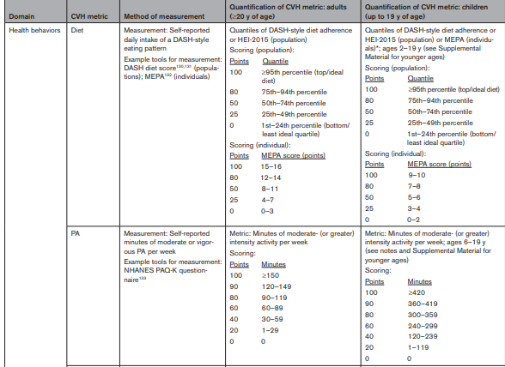
AHA, 2022
Notes:
BMI indicates body mass index; BP, blood pressure; CVH, cardiovascular health; DASH, Dietary Approaches to Stop Hypertension; FBG, fasting blood glucose; HbA1c, hemoglobin A1c; HDL, high-density lipoprotein; HEI, Healthy Eating Index; MEPA, Mediterranean Eating Pattern for Americans; NDS, nicotine-delivery system; NHANES, National Health and Nutrition Examination Surveys; PA, physical activity
PAQ-K, Physical Activity Questionnaire K; and
Mediterranean Diet Adherence Screener (MEDAS)
Mediterranean diet score

Slide 31
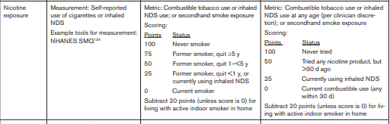
Nutrition Assessment: Lifestyle Factors
AHA, 2022
Notes:
SMQ, smoking assessment
Nicotine delivery system

Slide 32
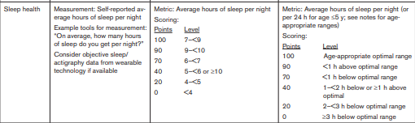
Nutrition Assessment: Lifestyle Factors
AHA, 2022

Slide 33
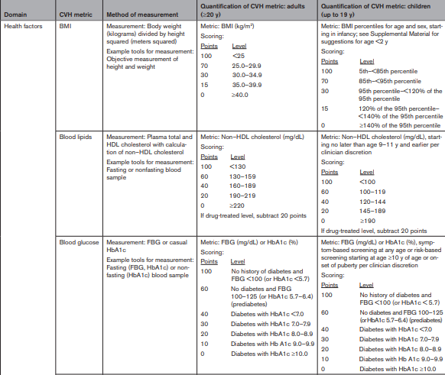
Nutrition Assessment: Clinical & Biochemical Factors
AHA, 2022

Slide 34
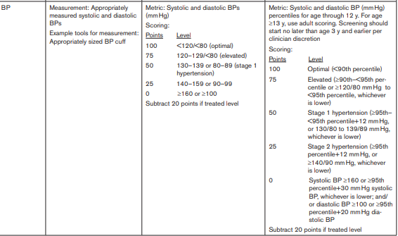
Nutrition Assessment: Clinical & Biochemical Factors
AHA, 2022

Slide 35
IV. B. CVH & the Nutrition Care Process: Diagnosis & Intervention

Slide 36
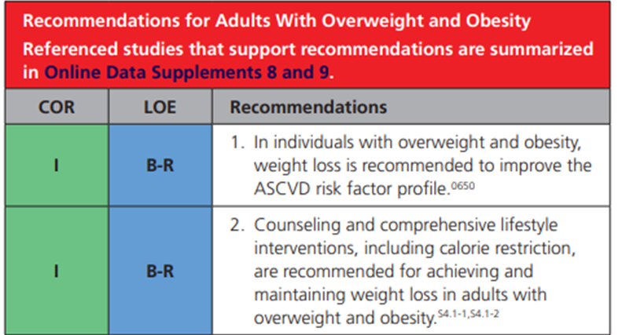
Weight Management in ASCVD
AHA, 2019

Slide 37
Weight Management in CVD
Adults with overweight/ obesity are advised to participate in comprehensive lifestyle programs of ≥6 months’ duration that assist participants in adhering to a diet therapy and increased physical activity.
  Help participants engage in high levels of physical activity (200 to 300 minutes/ week)
  Monitor body weight regularly (at least weekly)
  Consume a reduced-calorie diet
  Adults with obesity are typically prescribed a diet designed to reduce caloric intake by ≥500 kcal/ day from baseline
AHA, 2019

Slide 38

Weight Management in CVD
  Weight loss ≥5% initial weight is associated with moderate improvement in BP, LDL-C, triglyceride, and glucose levels among individuals with overweight/obesity
AHA, 2019
Notes:
Clinically meaningful weight loss (≥5% initial weight) is associated with moderate improvement in BP, low-density lipoprotein cholesterol (LDL-C), triglyceride, and glucose levels among individuals with overweight/obesity
A very-low-calorie diet (defined as < 800 kcal/d should be prescribed only in limited circumstances and only by trained clinicians in a medical care setting with the patient under medical supervision

Slide 39
Weight Management in CVD
    Limiting women to 1200 to 1500 kcal/d
    Limiting men to 1500 to 1800 kcal/day.
    A very-low-calorie diet (defined as < 800 kcal/d) should be prescribed only in limited circumstances and under medical supervision
AHA, 2019
Notes:
Clinically meaningful weight loss (≥5% initial weight) is associated with moderate improvement in BP, low-density lipoprotein cholesterol (LDL-C), triglyceride, and glucose levels among individuals with overweight/obesity
A very-low-calorie diet (defined as < 800 kcal/d should be prescribed only in limited circumstances and only by trained clinicians in a medical care setting with the patient under medical supervision

Slide 40

Weight Management in CVD
US Food and Drug Administration (FDA)–approved pharmacological therapies and bariatric surgery, adjunctive to complementary lifestyle interventions, additionally reduce weight and may have a role in weight loss for select patients.
AHA, 2019
Notes:
The present guideline document focuses primarily on lifestyle interventions for overweight and obesity, as outlined in

Slide 41

When to refer to bariatric surgery?
It is recommended for individuals:
  With BMI >35 kg/m² , regardless of presence, absence, or severity of comorbidities.
  With BMI >30 kg/m² + type 2 diabetes
  With BMI of 30–34.9 kg/m² who do not achieve substantial or durable weight loss or co-morbidity improvement using nonsurgical method
American Society of Metabolic and Bariatric Surgery and International Federation for the Surgery of Obesity and Metabolic Disorders (2022)

Slide 42
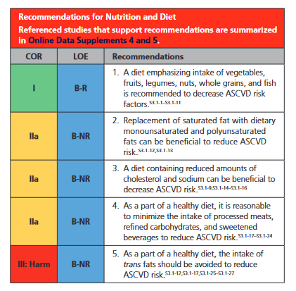
Nutrition & Diet Therapy
AHA, 2019

Slide 43

Nutrition & Diet Therapy
The Mediterranean diet (Med diet), the Dietary Approaches to Stop Hypertension (DASH), and plant-based diets all have proven cardioprotective in varying degrees and are endorsed by professional healthcare societies.
AHA, 2019

Slide 44

What is the Med Diet?
A dietary pattern inspired by the traditional eating habits of countries bordering the Mediterranean Sea.
Emphasizes whole foods, fresh ingredients, and a balanced approach to eating.
Rich in fruits, vegetables, whole grains, nuts, seeds, and olive oil
Fisher et. al., 2020, Diab e. al., 2023

Slide 45
What is the Med Diet?
Extra virgin olive oil (EVOO)
Fish
Natural cheese and yogurt
Poultry, fish or beans instead of red meat.
Little or no red meat.
Little or no sweets, sugary drinks or butter.
A moderate amount of wine with meals
Fisher et. al., 2020, Diab e. al., 2023

Slide 46
Characteristics of the Med Diet
Limits saturated fat and trans fat.
  High intake of saturated fat can raise LDL cholesterol.
  Trans fat has no health benefits.
Encourages healthy unsaturated fats, including omega-3 fatty acids.
  Promote healthy cholesterol levels,
  Support brain health and combat inflammation.
  Plus, a diet high in unsaturated fats and low in saturated fat promotes healthy blood sugar levels.
Limits sodium.
  Regulates blood pressure
Fisher et. al., 2020, Diab e. al., 2023
Notes:
Refined carbs also give you excess calories without much nutritional benefit. For example, such foods often have little or no fiber.
Limits saturated fat and trans fat.
Eating too much saturated fat can raise LDL cholesterol.
Trans fat has no health benefits.
Encourages healthy unsaturated fats, including omega-3 fatty acids.
Promote healthy cholesterol levels,
Support brain health and combat inflammation.
Plus, a diet high in unsaturated fats and low in saturated fat promotes healthy blood sugar levels.
Limits sodium.
Regulates blood pressure

Slide 47
Characteristics of the Med Diet
Limits refined carbohydrates, including sugar.
  Foods high in refined carbs cause blood sugar to spike.
Favors foods high in fiber and antioxidants.
  Reduce inflammation and neutralize free radicals
  Regulate bowel movements
  Maintain healthy blood sugar levels.
Fisher et. al., 2020, Diab e. al., 2023
Notes:
Refined carbs also give you excess calories without much nutritional benefit. For example, such foods often have little or no fiber.
Limits saturated fat and trans fat.
Eating too much saturated fat can raise LDL cholesterol.
Trans fat has no health benefits.
Encourages healthy unsaturated fats, including omega-3 fatty acids.
Promote healthy cholesterol levels,
Support brain health and combat inflammation.
Plus, a diet high in unsaturated fats and low in saturated fat promotes healthy blood sugar levels.
Limits sodium.
Regulates blood pressure

Slide 48
Benefits of the Med Diet
Supporting a healthy balance of gut microbiota (bacteria and other microorganisms) in the digestive system.
Lowering the risk for certain types of cancer.
Slowing the decline of brain function with aging.
Increasing longevity
Supports the environment→ sustainable dietary pattern
Lowering the risk of metabolic syndrome
  Improving blood pressure control
  Improving weight management
  Improving glycemia control
  Lowers triglycerides
  Lowering LDL cholesterol
  Improving immunity
Fisher et. al., 2020, Diab e. al., 2023

Slide 49
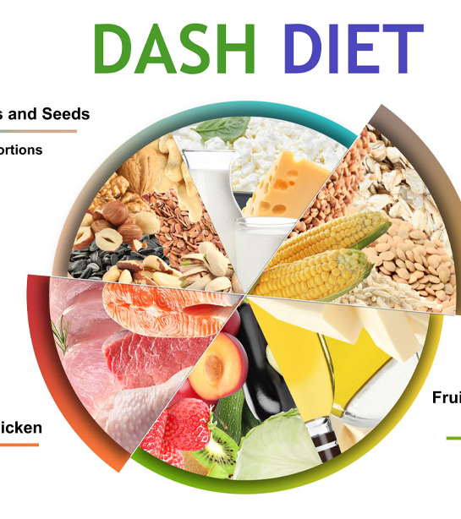
What is the DASH diet?
Created in 1997 by the National Heart Lung and Blood Institute to prevent and treat hypertension
  Focuses on vegetables, fruits and whole grains.
  Includes fat-free or low-fat dairy products
  Emphasizes lean proteins
    Fish, poultry, beans and nuts.
Appel et. al, 1997; Appel et. al., 2006

Slide 50
Characteristics of the DASH Diet
Limits saturated fat
  Such as in fatty meats and full-fat dairy products.
Limits added sugar
Limits foods that are high in salt/sodium.
  The standard diet limits salt to 2,300 milligrams (mg) a day (=1 teaspoon of table salt)
  A lower sodium version of DASH restricts sodium to 1,500 mg a day.
Appel et. al, 1997; Appel et. al., 2006
Notes:
Refined carbs also give you excess calories without much nutritional benefit. For example, such foods often have little or no fiber.
Limits saturated fat and trans fat.
Eating too much saturated fat can raise LDL cholesterol.
Trans fat has no health benefits.
Encourages healthy unsaturated fats, including omega-3 fatty acids.
Promote healthy cholesterol levels,
Support brain health and combat inflammation.
Plus, a diet high in unsaturated fats and low in saturated fat promotes healthy blood sugar levels.
Limits sodium.
Regulates blood pressure

Slide 51
Characteristics of the DASH Diet
Rich in minerals:
Potassium, calcium, magnesium,
High in fibers
Moderate in proteins
Low in saturated fat
Low in salt
Appel et. al, 1997; Appel et. al., 2006
Notes:
Refined carbs also give you excess calories without much nutritional benefit. For example, such foods often have little or no fiber.
Limits saturated fat and trans fat.
Eating too much saturated fat can raise LDL cholesterol.
Trans fat has no health benefits.
Encourages healthy unsaturated fats, including omega-3 fatty acids.
Promote healthy cholesterol levels,
Support brain health and combat inflammation.
Plus, a diet high in unsaturated fats and low in saturated fat promotes healthy blood sugar levels.
Limits sodium.
Regulates blood pressure

Slide 52
Additional Benefits of the DASH Diet
Lowering the risk of metabolic syndrome
  Improving blood pressure control
  Improving weight management
  Improving glycemia control
  Lowers triglycerides
  Lowering LDL cholesterol
Supporting a healthy balance of gut microbiota
Lowering the risk for certain types of cancer
Slowing the decline of brain function with aging.
Increasing longevity
Supports the environment→ sustainable dietary pattern
Diab et. al., 2024; Toorang et. al., 2022

Slide 53
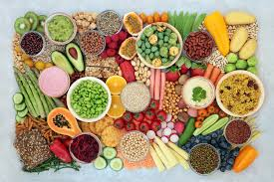
What is the Plant-based diet?
Diet plan that is vegetarian
Different types:
  Lacto-vegetarian: Exclude all animal
  products except dairy products
  Ovo-vegetarian: Exclude all animal
  products except eggs
  Lacto-ovo vegetarian Exclude all animal
  products except dairy products and eggs
  Pescatarian Exclude all animal products
  except fish.
  Vegan Exclude all animal products without
  any exceptions
The more foods are excluded, the harder it can be to get all the needed nutrients
Vegetarian diets are best when they include small portions of animal products
Satija et. al., 2017
Notes:
These diets are assessed based on the vegetable content of the diet, but do not necessarily account for the sugar, fat, and sodium content, which can decrease the cardioprotective nature of a plant-based diet.

Slide 54
Characteristics of the Plant-Based Diet Diet
Foundation of a healthy plant-based diet:
  Focuses on whole grains, fruits, vegetables, nuts, and legumes
  Consists of a low frequency and content of animal food.
Low energy density
Low saturated fats
High fiber content
High in phytochemicals
High in antioxidants
Satija et. al., 2017
Notes:
Refined carbs also give you excess calories without much nutritional benefit. For example, such foods often have little or no fiber.
Limits saturated fat and trans fat.
Eating too much saturated fat can raise LDL cholesterol.
Trans fat has no health benefits.
Encourages healthy unsaturated fats, including omega-3 fatty acids.
Promote healthy cholesterol levels,
Support brain health and combat inflammation.
Plus, a diet high in unsaturated fats and low in saturated fat promotes healthy blood sugar levels.
Limits sodium.
Regulates blood pressure

Slide 55
Characteristics of the Plant-Based Diet Diet
Nutrients of concern:
  Proteins
  Calcium
  Vitamin D
  Omaga-3 fatty acids
  B12
  Iron
  Zinc
  Iodine
  Selenium
Potential Solutions:
  Fortified foods
  Dietary Supplements
  Routine annual checks ups
Satija et. al., 2017, Diab et. al., 2023
Notes:
Refined carbs also give you excess calories without much nutritional benefit. For example, such foods often have little or no fiber.
Limits saturated fat and trans fat.
Eating too much saturated fat can raise LDL cholesterol.
Trans fat has no health benefits.
Encourages healthy unsaturated fats, including omega-3 fatty acids.
Promote healthy cholesterol levels,
Support brain health and combat inflammation.
Plus, a diet high in unsaturated fats and low in saturated fat promotes healthy blood sugar levels.
Limits sodium.
Regulates blood pressure

Slide 56
Benefits of the Vegetarian Diet
Lowering the risk of metabolic syndrome
  Improving blood pressure control
  Improving weight management
  Improving glycemia control
  Lowers triglycerides
  Lowering LDL cholesterol
Improving immunity
Supporting a healthy balance of gut microbiota
Lowering the risk for certain types of cancer
Slowing the decline of brain function with aging.
Increasing longevity
Supports the environment→ sustainable dietary pattern
Satija et. al., 2017, Diab et. al., 2023

Slide 57
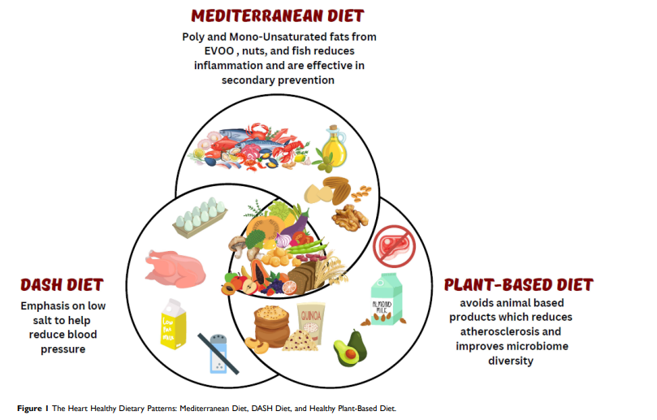
The dietary Trio
MIND Diet
(Mediterranean-DASH Intervention
for Neurodegenerative Delay diet)
Plant-Based Med Diet
Plant-Based DASH Diet
Diab et. al., 2023
Notes:
extra virgin olive oil (EVOO)
The Mediterranean, DASH, and healthy plant-based diets have more similarities than differences. Each of these diets emphasize fruits, vegetables, legumes, nuts, and whole grains. Diets rich in fruits and vegetables have been shown to be associated with lower risk of CVD and mortality.6,65 Increased whole grain consumption is also associated with lower risk of CVD and mortality.66 Higher consumption of nuts has also been shown to be associated with lower CVD risk.67 Eating minimally processed whole foods is an important component to all healthy diets, as consuming poor diet quality is one of the leading contributors to cardiometabolic disease globally.68,69 Ultra-processed foods are high in refined carbohydrates, added sugars, saturated and trans fats, sodium, and possibly artificial colors, flavors, and preservatives, and have high energy density and glycemic load, which all contribute to increased cardiometabolic risk factors. They also tend to be highly palatable so that individuals eat more calories in total.70 Furthermore, eating more ultra-processed foods can result in displacement of cardioprotective foods such as fruits and vegetables. In the Framingham Offspring Study, each additional serving a day of ultra-processed foods was associated with a 7% increased risk of incident CVD (HR=1.07; 95% CI=1.03–1.12).70 Similarly, in another cohort from Spain, each additional serving/ day of ultra-processed food was associated with 18% higher mortality (HR=1.18; 95% CI=1.05–1.33).71 In controlled feeding trials comparing diets that were matched for total calories, sugar, fat, fiber, and macronutrients, participants allowed ad libitum food intake ate ~500 kcal/day on the ultra-processed diet vs an unprocessed diet, and body weight changes were correlated with dietary differences in energy intake

Slide 58
What is the Most effective and recommended diet for cardiovascular health
1
3
2
Diab et. al., 2023
Notes:
Mediterranean diet remains one of the most effective and recommended balanced diets for cardiovascular health promotion, followed by the DASH diet for hypertension prevention and management, and healthy plant-based diet with careful consideration to its sugar and salt content as well as nutrient deficiencies

Slide 59
Promising Diets for Cardiovascular Health
Keto Diet/very low carbohydrates diets
Intermittent Fasting
  Alternate day fasting (ADF)
    The ADF pattern is having a fast day followed by a feast day
  Time restricted eating (TRE).
    Limits consumption of calories to a certain window of time each day, usually a 6–10 hour period.

Slide 60

Current Topics in Cardiovascular Health: The heart-gut axis
The relationship between cardiometabolic risk factors and the gut microbiome (the heart–gut axis) is an emerging area of study.
The gut microbiome is affected by:
dietary intake, antimicrobials, pre-and probiotics, with potential impact on cardiovascular risk factors.
Notes:
he relationship between cardiometabolic risk factors and the gut microbiome (the heart–gut axis) (Figure 2) is an emerging area of study.39,105 The gut microbiome is affected by dietary intake, antimicrobials, pre-and pro-biotics, and fecal microbial transplant, with potential impact on cardiovascular risk factors. For example, probiotics use has shown benefits in mild reduction in blood pressure, blood glucose, and TMAO levels.106 Higher fiber intake is associated with increased diversity of the gut microbiota,38 and a higher fiber diet is associated with lower risk of hypertension and CVD.

Slide 61
Current Topics in Cardiovascular Health: The heart-gut axis
  Probiotics use has shown benefits in mild reduction in blood pressure, blood glucose, and TMAO levels.
  Higher fiber intake is associated with increased diversity of the gut microbiota, and a higher fiber diet is associated with lower risk of hypertension and CVD.
Notes:
he relationship between cardiometabolic risk factors and the gut microbiome (the heart–gut axis) (Figure 2) is an emerging area of study.39,105 The gut microbiome is affected by dietary intake, antimicrobials, pre-and pro-biotics, and fecal microbial transplant, with potential impact on cardiovascular risk factors. For example, probiotics use has shown benefits in mild reduction in blood pressure, blood glucose, and TMAO levels.106 Higher fiber intake is associated with increased diversity of the gut microbiota,38 and a higher fiber diet is associated with lower risk of hypertension and CVD.

Slide 62
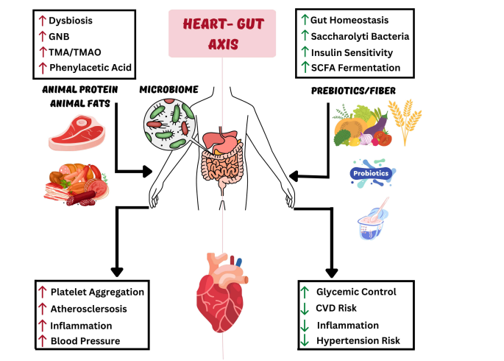
The Heart–Gut axis
Diab et. al., 2023
Notes:
Trimethylamine N-oxide (TMAO) is a metabolite that your body produces if you eat certain foods. Here’s how it works: when you consume foods rich in TMAO precursor compounds, the bacteria in your gut convert them into a molecule called trimethylamine (TMA). Your liver then grabs that TMA, does some fancy chemical stuff to it (apologies for that technical sidebar), and generates TMAO.
Gram-negative bacteria

Slide 63

Current Topics in Cardiovascular Health: Precision Nutrition
Based on the principle of one diet does not fit all
  Not limited to the impact of genes on nutrient response
  This relationship is reciprocal, and foods impact genome stability, the gut microbiome, and gene expression through epigenetic marks and other transcriptional regulatory mechanisms influencing both the proteome and the metabolome
Health professionals still have little knowledge on precision nutrition
  However, surveys show an interest of the general population in personalized treatments when guided by health professionals
Desjardin et. al., 2023

Slide 64
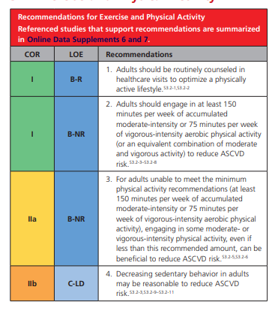
Physical Activity
AHA, 2019

Slide 65
IV. C. CVH & the Nutrition Care Process: Monitoring & Evaluation

Slide 66
IV. C. CVH & the Nutrition Care Process: Monitoring & Evaluation
Anthropometric (weight, BMI, waist circumference, % body fat, etc.)
Biochemical (blood glucose, lipids, homocysteine etc.)
Clinical (blood pressure, lifestyle, etc.)
Dietary (adherence to diet prescription, calories, etc.)

Slide 67
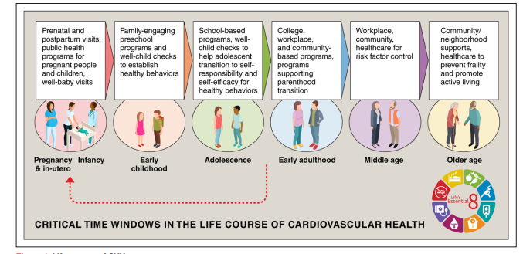
V. Life course of CVH
Notes:
The figure describes sensitive periods and transitions for cardiovascular health (CVH) across the life span, along with example opportunities for intervention to preserve or promote CVH at each age or stage. Opportunities to improve CVH occur across public health and policy, institutional, neighborhood- and community-level, and clinical contexts. Red arrow indicates the feedback loop of primordial prevention strategies that can maintain CVH through early life, leading to healthier parents before conception and a subsequent generation of healthier children.

Slide 68
VI. Conclusion
Most CVD events are avoidable through primordial prevention (the prevention of risk factor development).
  CVD is the end of the continuum
Cardiovascular health should be addressed in all life stages from preconception to elderly years
  Essential 8: Healthy diet, participation in physical activity, avoidance of nicotine, healthy sleep, healthy weight, and healthy levels of blood lipids, blood glucose, and blood pressure.
  Social determinants of health
  Patient centered therapy through a multidisciplinary approach

Slide 69

Case study: Meet Chadi
Age: 63 years Gender: Male Occupation: Accountant
Presenting Complaint: recently experienced a heart attack.
Medical History: family history of coronary artery disease.
Presenting Complaint: John recently experienced a heart attack.

Slide 70
Case study: Meet Chadi
1. Assessment
Physical Examination: Blood pressure: 140/90 mmHg, BMI: 28 kg/m².
Laboratory Findings: LDL cholesterol: 160 mg/dL, HDL:30 mg/dL, HBA1C: 5.4%
Current Treatments:
Medications: Taking antihypertensive medication and statin therapy for dyslipidemia.
Lifestyle: Limited physical activity, high intake of processed foods, minimal fruits and vegetables

Slide 71
Case study: Meet Chadi
2. Diagnosis
Recently experienced a heart attack
Unhealthy diet
Overweight
Sedentary
Hypertensive
High LDL
Low HDL

Slide 72
Case study: Meet Chadi
3. Intervention
Calorie-reduced diet (reduction of 500 Kcals)
DASH diet
Improving physical activity levels
Continuing & adjusting pharmacotherapy if needed
4. Monitoring & Evaluation
Weight measurements/Waist circumference assessment/body composition change
Dietary Assessment (DASH diet score)
Physical activity assessment (IPAQ, wearable devices, etc.)
Blood pressure assessment
Lipid profile assessment
-

